Slide 1

NLP Classifying Positive & Negative Restaurant Reviews
(Bag of Words Model)
BACHELOR OF TECHNOLOGY
DEPARTMENT OF COMPUTER SCIENCE & ENGINEERING
N.B.K.R INSTITUTE OF SCIENCE AND TECHNOLOGY
(Autonomous)
(Approved by AICTE: Accredited by NBA: Affiliated to JNTUA, Ananthapuramu)
An ISO 9001-2000 Certified Institution
Vidyanagar- 524413, Tirupati District, Andhra Pradesh, India
(2019-2023)
TEAM
P. VARSHITHA - 19KB1A05C5
P. POORNIMA - 19KB1A05B9
P. SAI VARDHAN - 19KB1A05C0
P. SAI -19KB1A05C6
UNDER THE GUIDANCE OF
Mr. K. Penchalaiah, B.Tech., M.Tech.,
Asst. Professor, Dept. of CSE

Slide 2
Contents:
Abstract
Introduction
Existing system
Literature Survey
Proposed system
Modules
UML Diagrams
System Architecture
Requirements
Snapshots
Conclusion
Future enhancements
References

Slide 3
ABSTRACT:
The use of social networking sites has increased tremendously. People use social media platforms to share their views on almost all subjects. These views are in various forms like, blogs, tweets, Facebook posts, online discussion boards, Instagram posts, etc. Sentiment analysis deals with the process of computationally defining and classifying the views expressed in the comment, post or document. Typically, the aim of sentiment analysis is to find out the customer’s attitude towards a product or service.
In this project, we perform sentiment analysis and classifies each comment as positive, negative. Secondly, by using text categorization techniques, comments are automatically classified according to feedback about food taste, ambiance, service, and value for money. A dataset of around 1000 records was used for training and testing. Several algorithms were used for classification, including Gaussian and multinomial Naive Bayes, Logistic Regression, Decision Tree, K-Nearest Neighbours(KNN), Support Vector Machine (SVM), XGBoost and Random Forest classification tech. The performance comparison of these algorithms is presented.

Slide 4
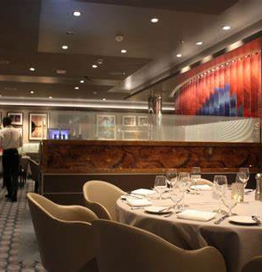
INTRODUCTION:
From the past few decades, the massive use of the internet has led to an increase in online activities such as; social media communication, e-commerce, blogging, surfing, etc .
The customers feedback is highly massive through internet, for the satisfaction of the product or service.
This usage has also created a huge impact on different business.
This trend has been very helpful for the restaurant’s customers as it becomes easier to select a good restaurant for specific cuisine.
It also help customers to identify the best dining place, in terms of taste, ambiance, and customer service.

Slide 5
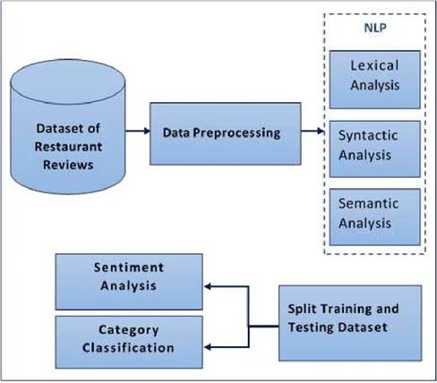
Existing System:
The dataset has been created by collecting users’ posts from social media group “SWOT” which contains customer reviews regarding different Pakistani restaurants.
The proposed model uses NLP technique for the tokenization of the textual features from the customer reviews.
This framework is implemented using four different classification models i.e. LR (Linear Regression), NBC(Naive , SVM and Random Forest.
The maximum accuracy was achieved by Random Forest algorithm that is, above 72% in sentiment analysis and category classification.

Slide 6
Literature Survey:
A. Krishna, V. Akhilesh, A. Aich, and C. Hegde, “Sentiment Analysis of Restaurant Reviews Using Machine Learning Techniques,” in Lecture Notes in Electrical Engineering, 2019, vol. 545, pp. 687–696.
This study analyses the restaurant reviews and presents useful information that the ratings do not consider or overlook Machine learning algorithms like Naive Bayes, RandomForest classification, Decision tree classification, K-Nearest Neighbors Classification, XGBclassification used for first classifying the reviews in proper aspects then performing sentiment analysis on them. Summarization is done using genism and results are displayed using effective visualization techniques.
This project deals with the collection of the right dataset for classification and sentiment analysis. The dataset for aspect classification has been collected from the Kaggle website competition which contains the reviews and the labels associated with the aspects. The labeled dataset for sentiment analysis is taken from Kaggle
And also deals with the aspect classification and preprocessing part for sentiment analysis. It includes stopwords removal, lemmatization, stemming, etc. It is the product of . Finally, the dataset is prepared into vectors using countvectorizer sentiment prediction

Slide 7
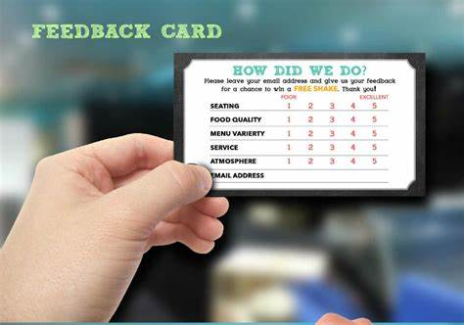
Proposed System:
Mostly, restaurant owners face a lot of difficulties to improve their productivity. A lot of businesses are remained as failures due to lack of profit and proper improvement measures.
This project really helps those who want to increase their productivity, which in turn increases their business profits.
The main objective of this project is to know about the drawbacks of his/her customer review about the food items.
The ML classification algorithm like GuassianNB, multinomialNB and XGBoost are added up to the existing system to obtain the better accuracy rate and gets stored in the database using SQLite.
Here the result can be obtained faster than the existing system.

Slide 8
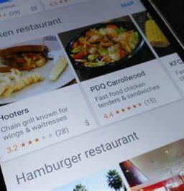
Modules:
USER
Login
Gives Feedback about the restaurant
Exists for the session
SYSTEM ADMIN
Login
Collection of reviews
Pre-processing the data
Analysis and returns the output.
MANAGER
Gives raw data to the system admin
Manages the restaurant

Slide 9
UML DIAGRAM:
UU
USE CASE DIAGRAM

Slide 10
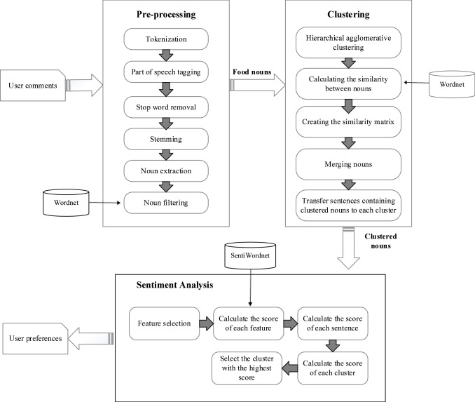
SYSTEM ARCHITETURE:

Slide 11
REQUIREMENTS:
HARDWARE:
Processor: i3
Ram capacity: 4GB
Hard disk: 150 GB
SOFTWARE:
Operating system: windows 10
Technologies: Python
Tools: Jupiter Notebook

Slide 12
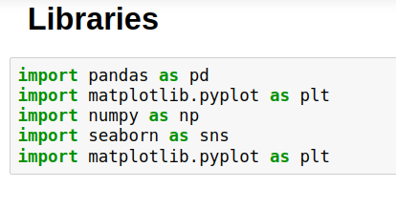
SNAPSHOTS

Slide 13
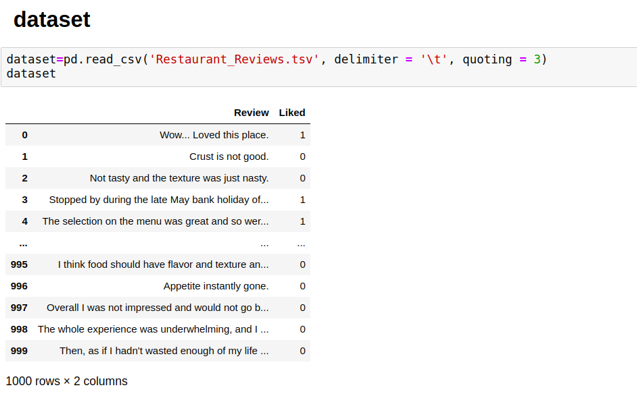

Slide 14
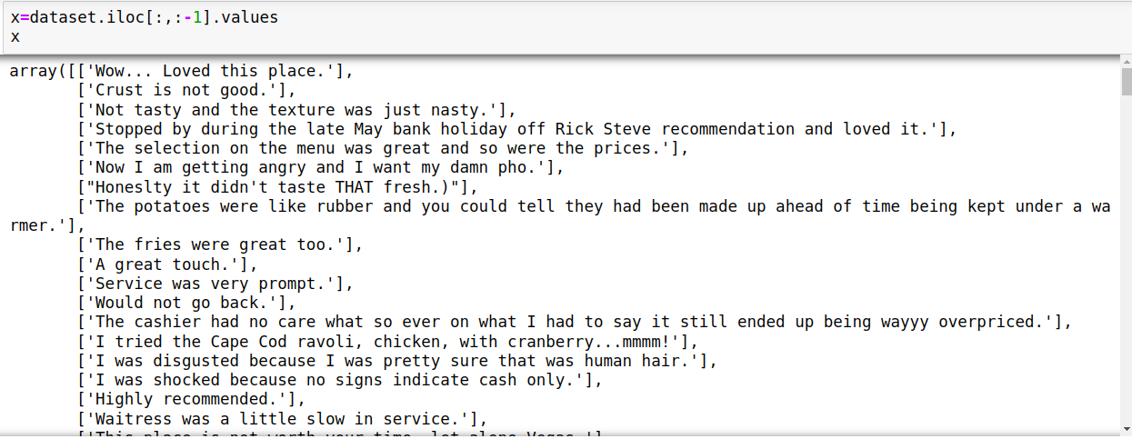

Slide 15
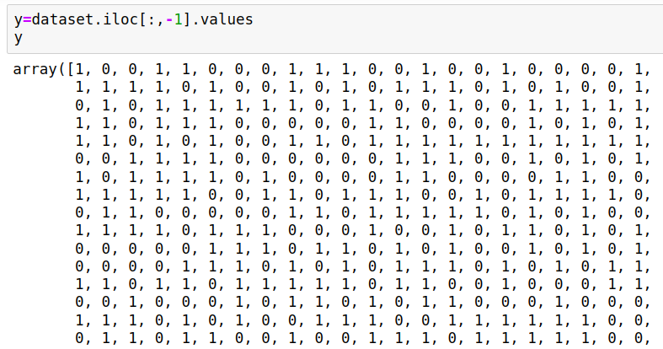

Slide 16
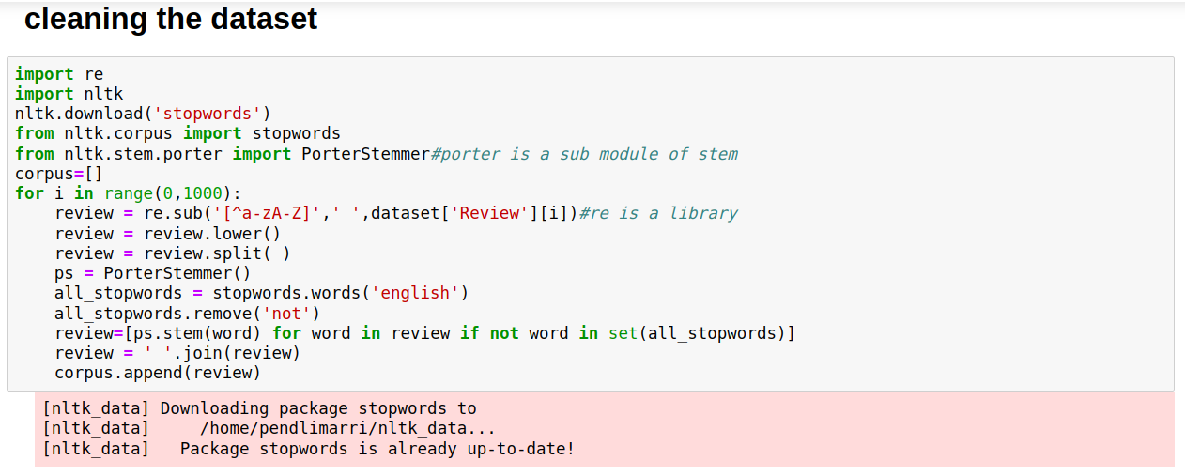

Slide 17
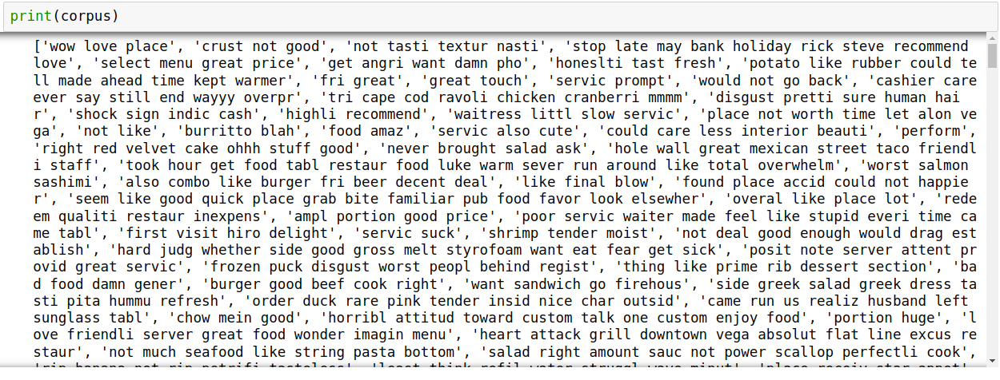

Slide 18
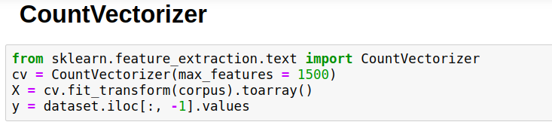
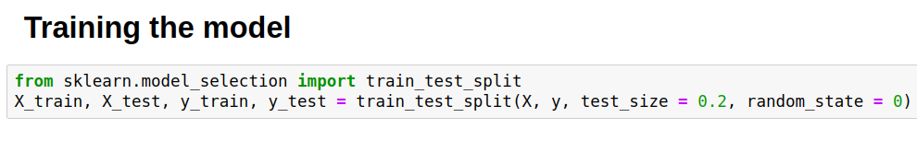

Slide 19
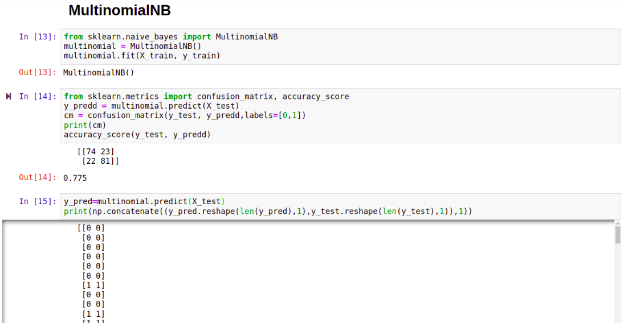

Slide 20
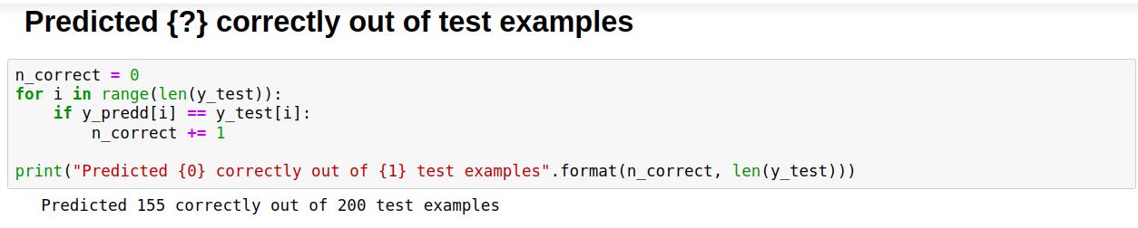

Slide 21
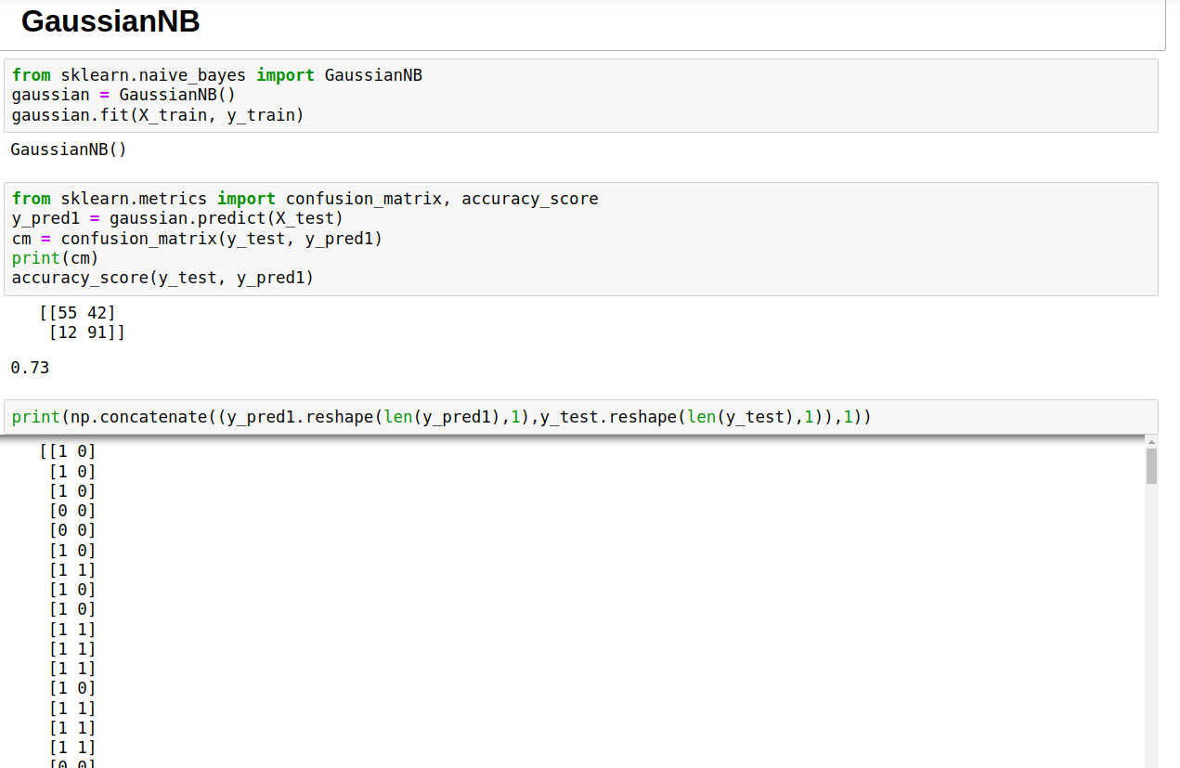

Slide 22
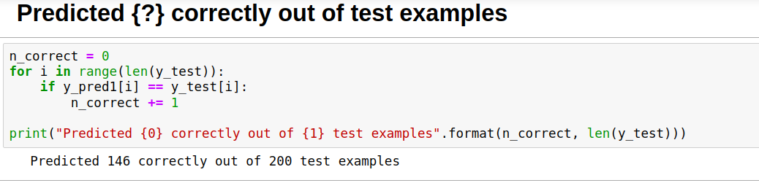

Slide 23
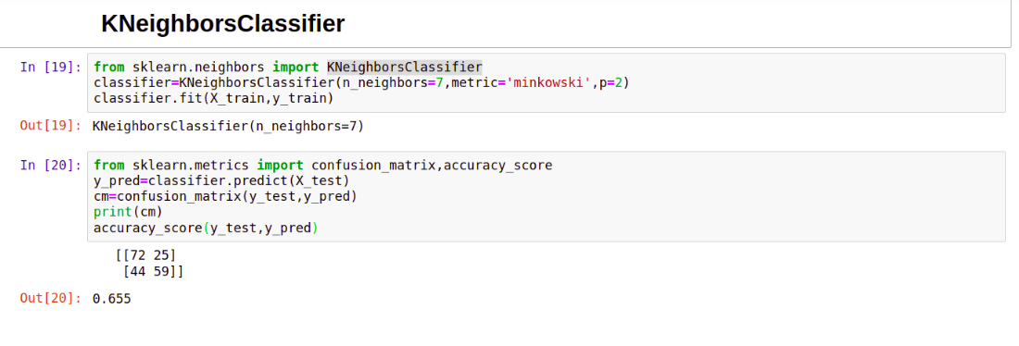

Slide 24
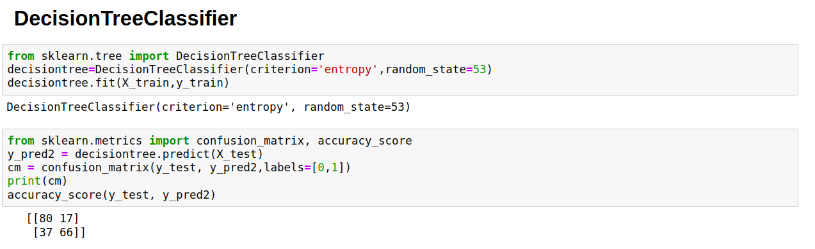

Slide 25
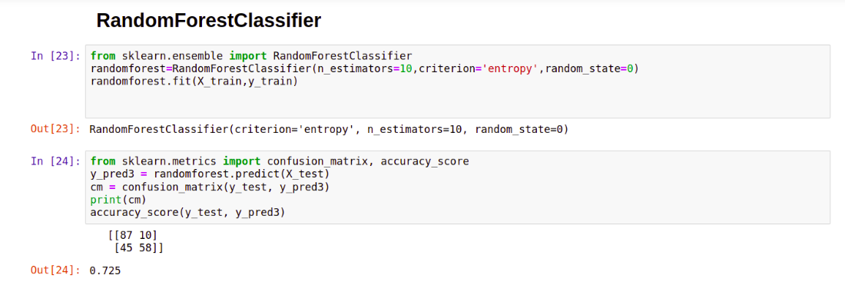

Slide 26
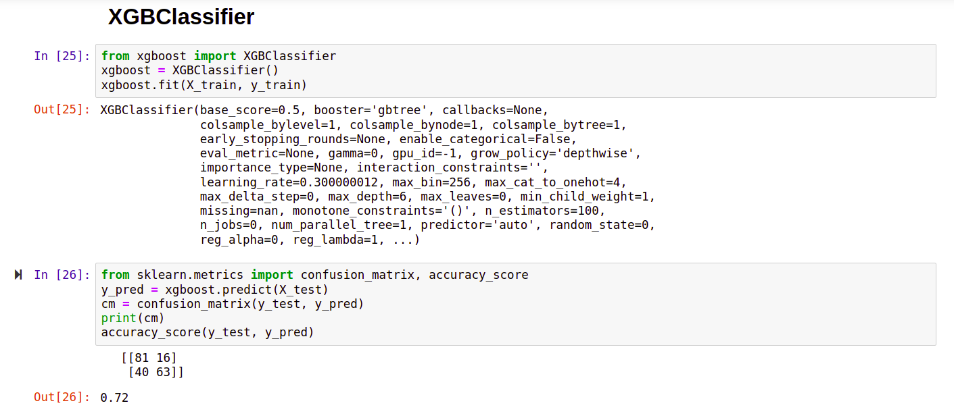

Slide 27
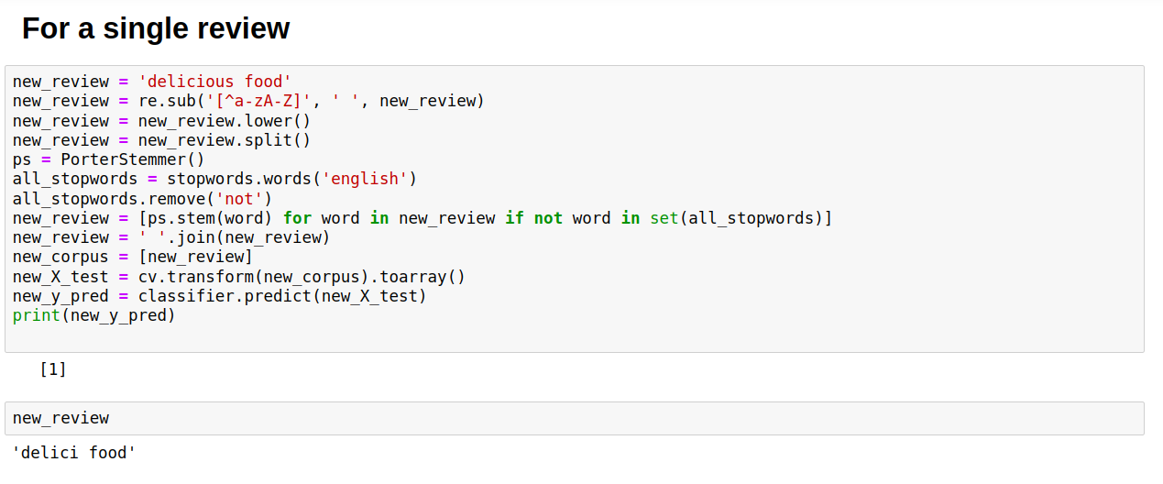

Slide 28
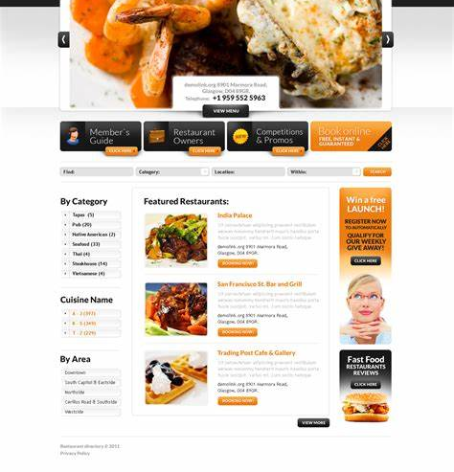
Conclusion:
In our study, we proposed a lexicon-based approach to classify customer reviews in restaurant domain.
Sentiment analysis proved to be successful may be useful in real-world applications to extract sentiment from text resources, as the precision for the class labels representing positive and negative.
Sentiment showed to be remarkably high put simply, if a customer review is classified as positive or negative the classification is correct with a probably of about 77.5%.
In this project we are going for a single review prediction.

Slide 29
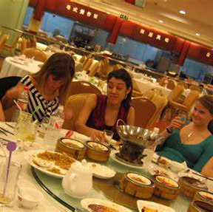
Future Enhancements:
The ‘NOT’ implementation –
If the review is ‘NOT GOOD’, it shows a positive review.
If the review is ‘NOT BAD’, it shows a negative review.
Here 'not' is removed so that the prediction rate increases.

Slide 30
References:
T. Piñeiro-Otero and X. Martínez-Rolan, “Understanding Digital Marketing—Basics and Actions,” Springer, Cham, 2016, pp. 37–74.
T. Y. Lee and E. T. Bradlow, “Automated Marketing Research Using Online Customer Reviews,” J. Mark. Res., vol. 48, no. 5, pp. 881–894, Oct. 2011.
M. Fikri and R. Sarno, “A comparative study of sentiment analysis using SVM and Senti Word Net,” Indones. J. Electr. Eng. Comput. Sci., vol. 13, no. 3, pp. 902–909, Mar. 2019.
J. Guerreiro and P. Rita, “How to predict explicit recommendations in online reviews using text mining and sentiment analysis,” J. Hosp. Tour. Manag., vol. 43, pp. 269–272, Jun. 2020.

Slide 31


